Slide 1


micro:bit entry video tutorial
Lesson 15
micro:bit lesson 15 “Don't touch me”
YahBoom micro:bit module tutorial

Slide 2
micro:bit entry video tutorial
Content
Part1
Part 2
Part3
Part 4
Part 5
Learning goals
Preparation
Connection
Search for blocks
Combine blocks
YahBoom micro:bit module tutorial

Slide 3
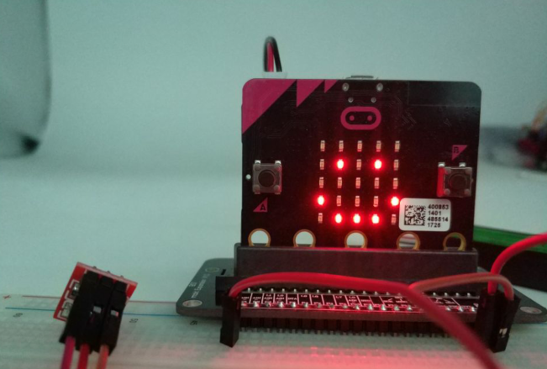
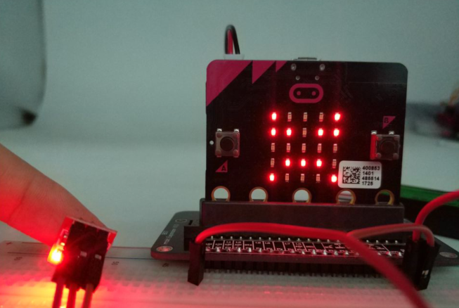
micro:bit entry video tutorial
Part 1
Learning goals
Today we need a touch switch for our experiment. When children touch the touch switch, there will be an angry pattern on the dot matrix of micro:bit. On the contrary, if no one touches the touch switch, there is a happy pattern on the dot matrix.
YahBoom micro:bit module tutorial

Slide 4
micro:bit entry video tutorial
Part 2
Hardware:
● 1 X Micro: bit Board
● 1 X Micro USB Cable
● 1 X Micro:bit breakout
● 3 X Male to male cable
● 1 X 830 holes breadboard
● 1 X Touch sensor
Preparation
Then the micro:bit is connected to the computer through USB, and the computer will pop up a U disk and click the URL in the U disk to enter the programming interface. Input this URL https://github.com/lzty634158/yahboom_mbit_en to get the package.
YahBoom micro:bit module tutorial

Slide 5
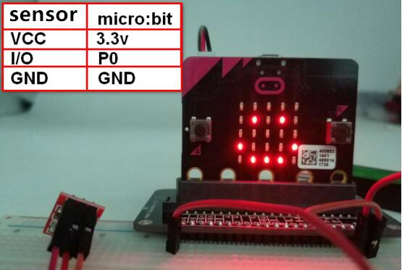
micro:bit entry video tutorial
Part 2
Connection
Connection line according to the upper drawing.
YahBoom micro:bit module tutorial

Slide 6
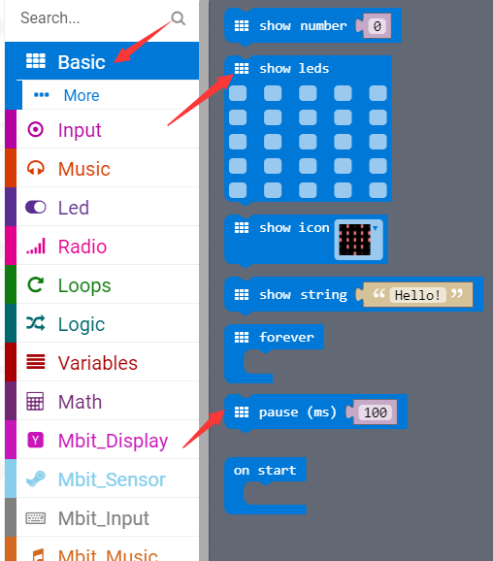
micro:bit entry video tutorial
Part 3
Search for blocks
YahBoom micro:bit module tutorial

Slide 7
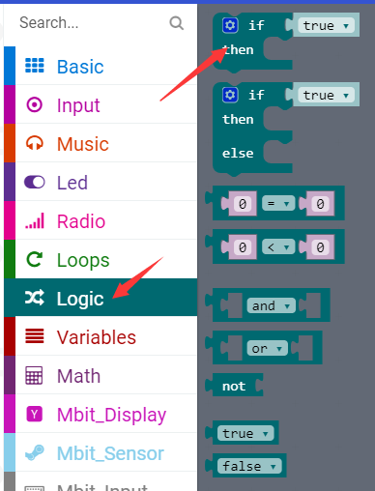
micro:bit entry video tutorial
Part 3
Search for blocks
YahBoom micro:bit module tutorial

Slide 8
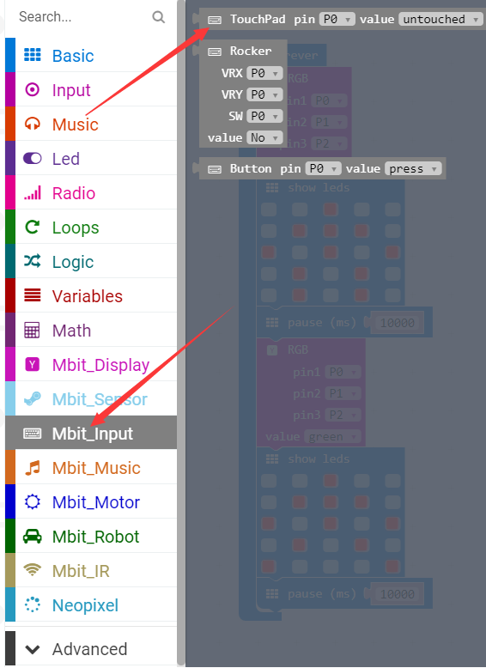
micro:bit entry video tutorial
Part 3
Search for blocks
YahBoom micro:bit module tutorial

Slide 9
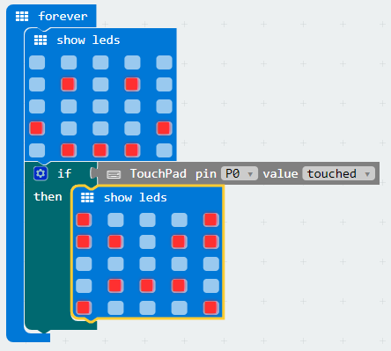
micro:bit entry video tutorial
Part 4
Combine blocks
YahBoom micro:bit module tutorial

Slide 10
micro:bit entry video tutorial
micro:bit
project
Thanks for watching！
Powered by YahBoom
YahBoom micro:bit module tutorial

